Slide 1


Credit Card Fraud Detection and Cost Optimization Using Statistical Optimization Techniques
This presentation explores how statistical optimization techniques can enhance credit card fraud detection while minimizing costs associated with misclassification errors. We focus on methods like Linear Programming, Quadratic Programming, and Gradient Descent applied to real-world transaction data.
Our goal is to build an optimization-based model that balances fraud detection accuracy with cost efficiency, addressing the challenges faced by financial institutions in the digital economy.
by Amartya Amritanshu , Aayush Jha , Paduri Sanjith Reddy

Slide 2

Problem Context and Research Questions
Context and Motivation
Research Problem
Research Question
Global payment card fraud losses exceed $32 billion annually, with online transactions most vulnerable. Detecting fraud is critical to security and cost optimization, balancing false positives and false negatives.
How to build an optimization model that accurately detects fraud while minimizing expected misclassification costs?
Can we formulate and solve an optimization problem using real transaction data to minimize total expected cost from false positives and false negatives?

Slide 3
Plan and Methodology
Objective
Optimization Formulation
Develop an optimization model classifying transactions as fraud or non-fraud, minimizing expected classification error costs.
Define decision variables and fraud probability
Objective function based on expected misclassification cost
Data Collection & Preparation
Constraints from transaction patterns
Use Kaggle Credit Card Fraud Detection dataset
Solution Approach & Tools
Clean, preprocess, scale features, and balance data with SMOTE
Linear/Quadratic Programming, Gradient Descent
Python/R with cvxpy, scikit-learn, pandas

Slide 4
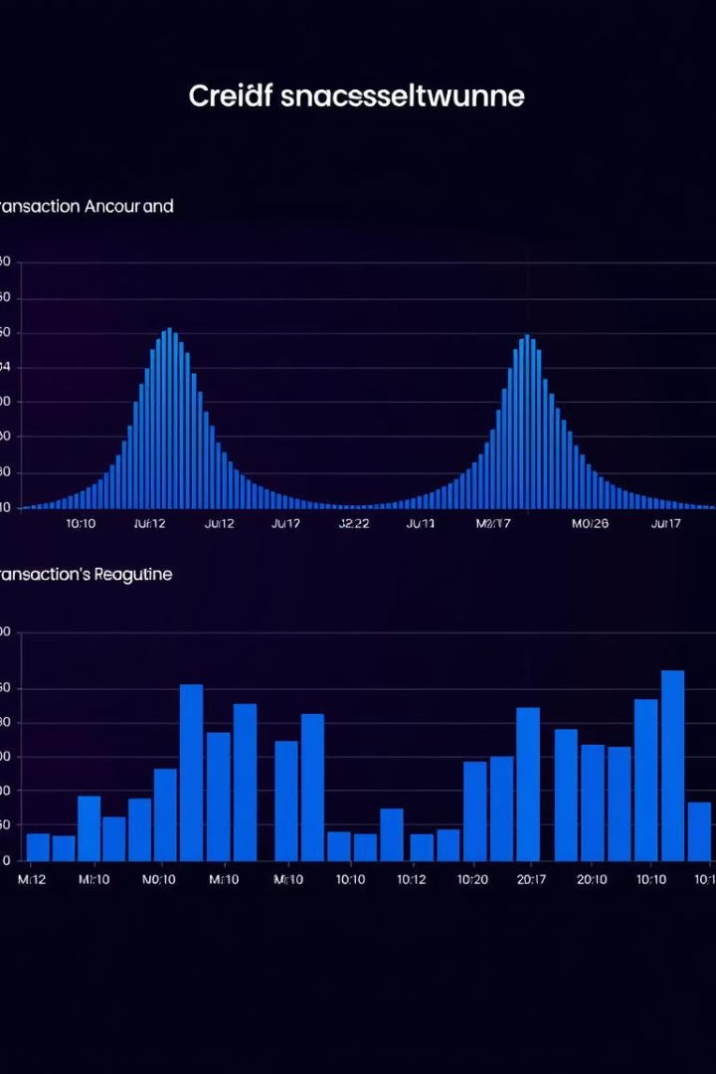
Data Description and Cleaning
Dataset Overview
Over 284,000 transactions with 492 fraud cases (0.17%). Features include time, amount, and 28 anonymized PCA components.
Data Cleaning
No missing values found
Normalized 'Amount' using Min-Max scaling
Split into 80% training and 20% test sets
Balanced classes using SMOTE to address imbalance

Slide 5
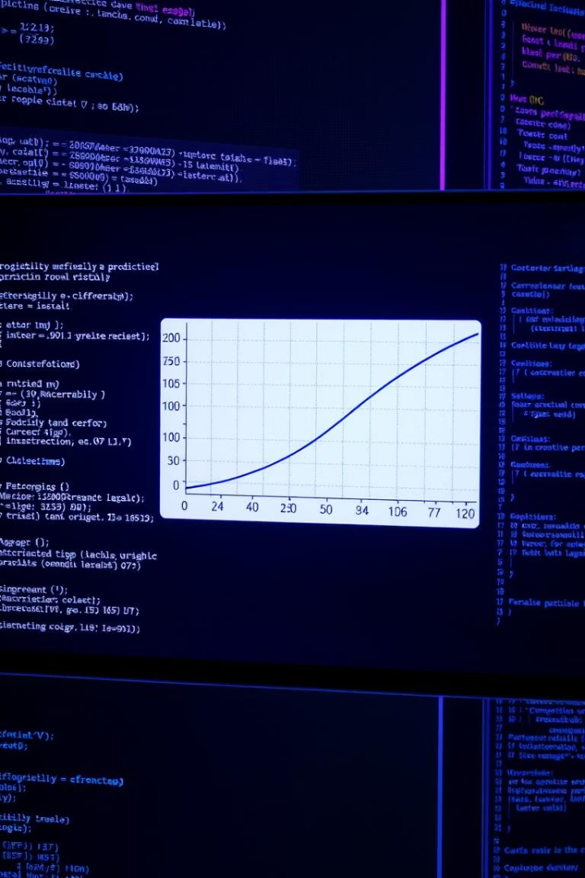



Analysis and Optimization Problem Formulation
Descriptive Statistics
Analyzed transaction amounts and time distributions; visualized class imbalance and PCA feature correlations.
Optimization Model
Minimize expected cost combining false positives and false negatives using logistic regression probabilities.
Mathematical Formulation
Nonlinear problem approximated via Gradient Descent or Quadratic Programming after linearization.

Slide 6
Model Implementation and Random Components
Random Variables and Distributions
Convex Optimization Models
Fraud probability modeled by logistic function; feature uncertainty assumed multivariate normal.
Logistic Regression with weighted costs
Linear Programming for threshold optimization
Monte Carlo simulations estimate expected costs under uncertainty.
Quadratic Programming for regularized cost minimization
Implemented using Python's cvxpy library.

Slide 7
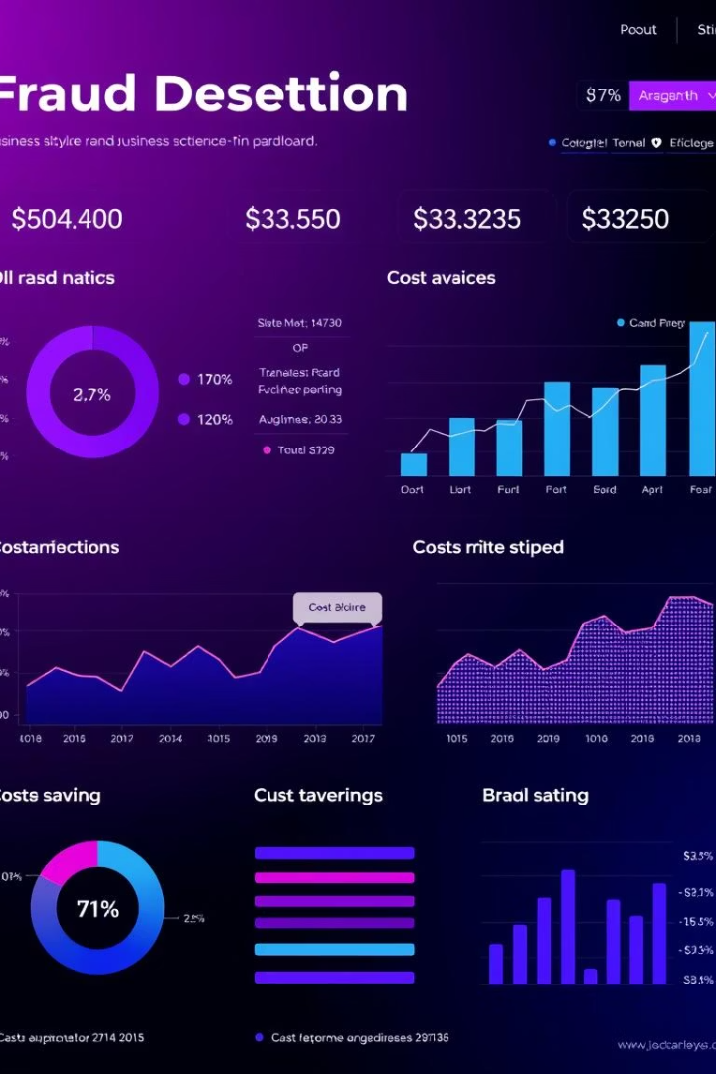
Findings and Performance
Key Results
Cost Sensitivity
Quadratic Programming model achieved lowest expected cost compared to other models.
False negatives cost more than false positives; optimizing recall improved business outcomes.
Cost Reduction
Optimized threshold reduced average cost per transaction by approximately 35% versus default logistic regression.

Slide 8
Conclusion, Limitations, and Future Work
Conclusion
Limitations
Future Work
Cost-sensitive optimization significantly enhances fraud detection performance, especially with asymmetric misclassification costs.
Anonymized dataset limits feature interpretability
Incorporate time-series for dynamic detection
Real-time deployment requires additional infrastructure
Integrate reinforcement learning for adaptive cost optimization
Cost assumptions may vary across institutions
Deploy model in cloud for real-time inference

Slide 9

Project Contributions and Resources
1
Aayush Jha (BSDCC2401)
Led optimization problem formulation and gradient descent implementation.
2
Amartya Amritanshu (BSDCC2405)
Handled data preprocessing, visualization, and LP/QP formulation.
3
Paduri Sanjith Reddy (VSDCC2412)
Designed cost model, performed sensitivity analysis, and prepared presentation slides.
All source code, raw data, and intermediate outputs are available in the Zipfile.

